Slide 1
Setting the record straight

Slide 2
AI can lie

Slide 3
AI can lie
So can colleagues

Slide 4
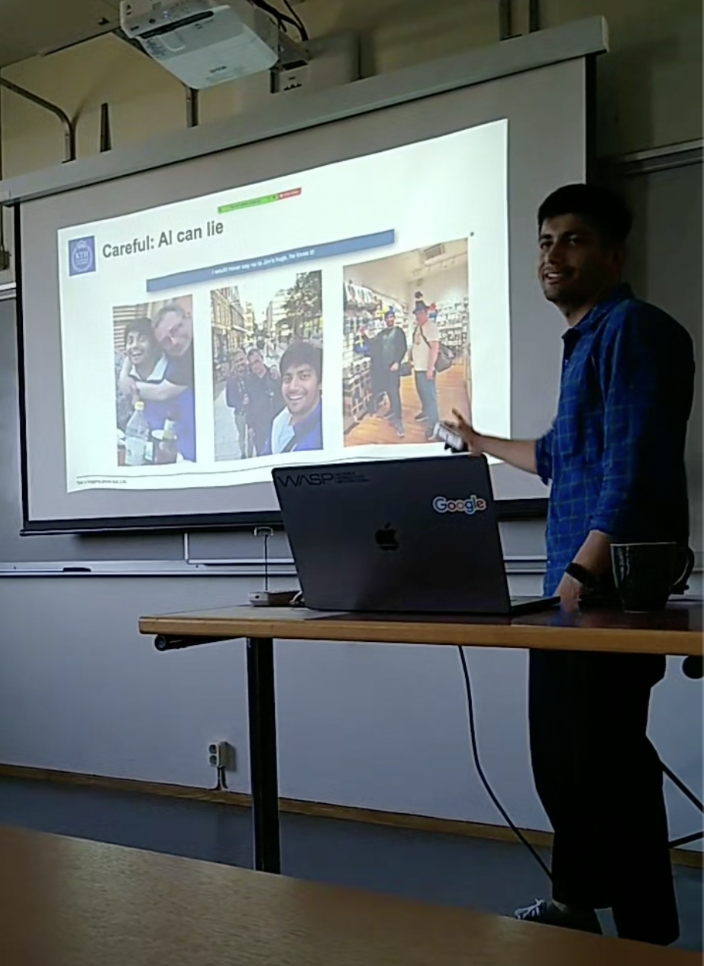
AI can lie
So can colleagues

Slide 5

Truth

